Slide 1
WEB TECHNOLOGY AND ITS APPLICATIONS
18CS63
Dr. GANESH D R
ASSISTANT PROFESSOR,
DEPT OF ISE,
CMRIT

Slide 2
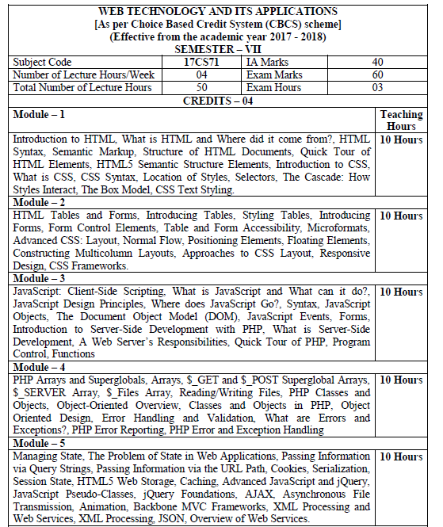

Slide 3
HTML 1: Overview
Chapter 2

Slide 4
HTML defined + its history
Section 1 of 6

Slide 5
Brief History of HTML
ARPANET of the late 1960s
Jump quickly to the first public specification of the HTML by Tim Berners-Lee in 1991
HTML’s codification by the World-Wide Web Consortium (better known as the W3C) in 1997.

Slide 6
HTML Syntax
What is a markup language?
HTML is defined as a markup language.
A markup language is simply a way of annotating a document in such a way to make the annotations distinct from the text being annotated.
The term comes from the days of print, when editors would write instructions on manuscript pages that might be revision instructions to the author or copy editor.

Slide 7
Markup
What is it again?
At its simplest, markup is a way to indicate information about the content
This “information about content” in HTML is implemented via tags (aka elements).
The markup in the previous slide consists of the red text and the various circles and arrows on the one page, and the little yellow sticky notes on the other.
HTML does the same thing but uses textual tags.

Slide 8
Sample ad hoc markup

Slide 9
What is the W3C?
Standards
The W3C is the main standards organization for the World Wide Web.
To promotes compatibility the W3C produces recommendations (also called specifications).
In 1998, the W3C turned its attention to a new specification called XHTML 1.0, which was a version of HTML that used stricter XML (Extensible Markup Language) syntax rules.

Slide 10
XHTML
Partying like it’s 1999
The goal of XHTML with its strict rules was to make page rendering more predictable by forcing web authors to create web pages without syntax errors.

Slide 11
XHTML
You too can be strict
The XML-based syntax rules for XHTML are pretty easy to follow.
The main rules are:
lowercase tag names,
attributes always within quotes,
and all elements must have a closing element (or be self-closing).

Slide 12
XHTML
Two versions
To help web authors, two versions of XHTML were created:
XHTML 1.0 Strict and XHTML 1.0 Transitional.
The strict version was meant to be rendered by a browser using the strict syntax rules and tag support described by the W3C XHTML 1.0 Strict specification.
The transitional recommendation is a more forgiving flavor of XHTML, and was meant to act as a temporary transition to the eventual global adoption of XHTML Strict.

Slide 13
Standards Movement
Following a standard is a good thing
During much of the 2000s, the focus in the professional web development community was on standards: that is, on limiting oneself to the W3C specification for XHTML.

Slide 14
Validators
How to ensure your pages follow a standard
A key part of the standards movement in the web development community of the 2000s was the use of HTML Validators as a means of verifying that a web page’s markup followed the rules for XHTML transitional or strict.

Slide 15
How about an example
Only if you have an internet connection
Open a web browser to the W3C validator and find a few websites to test.
Type the URL into the bar, and you can check if the home page is valid against various standards (or auto-detect)

Slide 16
XHTML 2.0 and WHATWG
Where did it go?
In the mid 2000s, XHTML 2.0 proposed a revolutionary and substantial change to HTML.
backwards compatibility with HTML and XHTML 1.0 was dropped.
Browsers would become significantly less forgiving of invalid markup.
At around the same time, a group of developers at Opera and Mozilla formed the WHATWG (Web Hypertext Application Technology Working Group) group within the W3C.
This group was not convinced that the W3C’s embrace of XML and its abandonment of backwards-compatibility was the best way forward for the web.

Slide 17
HTML5
The new hotness
By 2009, the W3C stopped work on XHTML 2.0 and instead adopted the work done by WHATWG and named it HTML5.
There are three main aims to HTML5:
Specify unambiguously how browsers should deal with invalid markup.
Provide an open, non-proprietary programming framework (via Javascript) for creating rich web applications.
Be backwards compatible with the existing web.

Slide 18
HTML5
It evolves
While parts of the HTML5 are still being finalized, all of the major browser manufacturers have at least partially embraced HTML5.
Certainly not all browsers and all versions support every feature of HTML5.
This is in fact by design. HTML in HTML5 is now a living language: that is, it is a language that evolves and develops over time.
As such, every browser will support a gradually increasing subset of HTML5 capabilities

Slide 19
HTML5 Support in Browsers

Slide 20
HTML SYNTAX
Section 2 of 6

Slide 21
Elements and Attributes
More syntax
HTML documents are composed of textual content and HTML elements.
An HTML element can contain text, other elements, or be empty. It is identified in the HTML document by tags.
HTML elements can also contain attributes. An HTML attribute is a name=value pair that provides more information about the HTML element.
In XHTML, attribute values had to be enclosed in quotes; in HTML5, the quotes are optional.

Slide 22
What HTML lets you do
Insert images using the <img> tag
Create links with the <a> tag
Create lists with the <ul>, <ol> and <li> tags
Create headings with <H1>, <H2>, …, <H6>
Define metatdata with <meta> tag
And much more…

Slide 23
Elements and Attributes

Slide 24
Nesting HTML elements
Often an HTML element will contain other HTML elements.
In such a case, the container element is said to be a parent of the contained, or child, element.
Any elements contained within the child are said to be descendents of the parent element; likewise, any given child element, may have a variety of ancestors.

Slide 25
Hierarchy of elements

Slide 26
Nesting HTML elements
In order to properly construct a hierarchy of elements, your browser expects each HTML nested element to be properly nested.
That is, a child’s ending tag must occur before its parent’s ending tag.

Slide 27
SEMANTIC MARKUP
Section 3 of 6

Slide 28
Semantic Markup
What does it mean?
Over the past decade, a strong and broad consensus has grown around the belief that HTML documents should only focus on the structure of the document.
Information about how the content should look when it is displayed in the browser is best left to CSS (Cascading Style Sheets).
As a consequence, beginning HTML authors are often counseled to create semantic HTML documents.
That is, an HTML document should not describe how to visually present content, but only describe its content’s structural semantics or meaning.

Slide 29
Structure
Structure is a vital way of communicating information in paper and electronic documents.
All of the tags that we will examine in this presentation are used to describe the basic structural information in a document, such as articles, headings, lists, paragraphs, links, images, navigation, footers, and so on.

Slide 30
Semantic Markup
Its advantages
Eliminating presentation-oriented markup and writing semantic HTML markup has a variety of important advantages:
Maintainability. Semantic markup is easier to update and change than web pages that contain a great deal of presentation markup.
Faster. Semantic web pages are typically quicker to author and faster to download.
Accessibility. Visiting a web page using voice reading software can be a very frustrating experience if the site does not use semantic markup.
Search engine optimization. Semantic markup provides better instructions for search engines: it tells them what things are important content on the site.

Slide 31
STRUCTURE OF HTML
Section 4 of 6

Slide 32
Simplest HTML document
The <title> element (Item) is used to provide a broad description of the content. The title is not displayed within the browser window. Instead, the title is typically displayed by the browser in its window and/or tab.

Slide 33
A more complete document

Slide 34
DOCTYPE
(short for Document Type Definition)
Tells the browser (or any other client software that is reading this HTML document) what type of document it is about to process.
Notice that it does not indicate what version of HTML is contained within the document: it only specifies that it contains HTML.

Slide 35
HTML, Head, and Body
HTML5 does not require the use of the <html>, <head>, and <body>.
However, in XHTML they were required, and most web authors continue to use them.
The <html> element is sometimes called the root element as it contains all the other HTML elements in the document.

Slide 36
Head and Body
HTML pages are divided into two sections: the head and the body, which correspond to the <head> and <body> elements.
The head contains descriptive elements about the document.
The body contains content that will be displayed by the browser.

Slide 37
Inside the head
There are no brains
You will notice that the <head> element contains a variety of additional elements.
The first of these is the <meta> element. Our example declares that the character encoding for the document is UTF-8.

Slide 38
Inside the head
No brains but metas, styles and javascripts
Our example specifies an external CSS style sheet file that is used with this document.
It also references an external Javascript file.

Slide 39
QUICK TOUR OF HTML
Section 5 of 6

Slide 40
Why a quick tour?
HTML5 contains many structural and presentation elements – too many to completely cover in this presentation.
Rather than comprehensively cover all these elements, this presentation will provide a quick overview of the most common elements.

Slide 41
Sample Document

Slide 42
Headings
<h1>, <h2>, <h3>, etc
HTML provides six levels of heading (h1, h2, h3, …), with the higher heading number indicating a heading of less importance.
Headings are an essential way for document authors use to show their readers the structure of the document.

Slide 43
Headings
The browser has its own default styling for each heading level.
However, these are easily modified and customized via CSS.

Slide 44
Headings
Be semantically accurate
In practice, specify a heading level that is semantically accurate.
Do not choose a heading level because of its default presentation
e.g., choosing <h3> because you want your text to be bold and 16pt
Rather, choose the heading level because it is appropriate
e.g., choosing <h3> because it is a third level heading and not a primary or secondary heading

Slide 45
Paragraphs
<p>
Paragraphs are the most basic unit of text in an HTML document.
Notice that the <p> tag is a container and can contain HTML and other inline HTML elements
Inline HTML elements refers to HTML elements that do not cause a paragraph break but are part of the regular “flow” of the text.

Slide 46
Divisions
<div>
This <div> tag is also a container element and is used to create a logical grouping of content
The <div> element has no intrinsic presentation.
It is frequently used in contemporary CSS-based layouts to mark out sections.

Slide 47
Using div elements
Can you say “div-tastic”
HTML5 has a variety of new semantic elements (which we will examine later) that can be used to reduce somewhat the confusing mass of div within divs within divs that is so typical of contemporary web design.

Slide 48
Links
<a>
Links are created using the <a> element (the “a” stands for anchor).
A link has two main parts: the destination and the label.

Slide 49
Types of Links
You can use the anchor element to create a wide range of links:
Links to external sites (or to individual resources such as images or movies on an external site).
Links to other pages or resources within the current site.
Links to other places within the current page.
Links to particular locations on another page.
Links that are instructions to the browser to start the user’s email program.
Links that are instructions to the browser to execute a Javascript function.

Slide 50
Different link destinations

Slide 51
Link Text
Some guidance … or … don’t “Click Here”
Links with the label “Click Here” were once a staple of the web.
Today, such links are frowned upon, since:
they do not tell users where the link will take them
as a verb “click” is becoming increasingly inaccurate when one takes into account the growth of mobile browsers.
Instead, textual link labels should be descriptive.
“Click here to see the race results”
“Race Results” or “See Race Results”.

Slide 52
URL Absolute Referencing
For external resources
When referencing a page or resource on an external site, a full absolute reference is required: that is,
the protocol (typically, http://),
the domain name,
any paths, and then finally
the file name of the desired resource.

Slide 53
URL Relative Referencing
An essential skill
We also need to be able to successfully reference files within our site.
This requires learning the syntax for so-called relative referencing.
When referencing a resource that is on the same server as your HTML document, then you can use briefer relative referencing. If the URL does not include the “http://” then the browser will request the current server for the file.

Slide 54
URL Relative Referencing
If all the resources for the site reside within the same directory (also referred to as a folder), then you can reference those other resources simply via their filename.
However, most real-world sites contain too many files to put them all within a single directory.
For these situations, a relative pathname is required along with the filename.
The pathname tells the browser where to locate the file on the server.

Slide 55
Pathnames
Pathnames on the web follow Unix conventions.
Forward slashes (“/”) are used to separate directory names from each other and from file names.
Double-periods (“..”) are used to reference a directory “above” the current one in the directory tree.

Slide 56
URL Relative Referencing
Relative Link Type | Example
Same Directory To link to a file within the same folder, simply use the file name. | To link to example.html from about.html (in Figure 2.18), use: <a href="example.html">
Child Directory To link to a file within a subdirectory, use the name of the subdirectory and a slash before the file name. | To link to logo.gif from about.html, use: <a href="images/logo.gif">
Grandchild/Descendant Directory To link to a file that is multiple subdirectories below the current one, construct the full path by including each subdirectory name (separated by slashes) before the file name. | To link to background.gif from about.html, use: <a href="css/images/background.gif">
Parent/Ancestor Directory Use “../” to reference a folder above the current one. If trying to reference a file several levels above the current one, simply string together multiple “../”. | To link to about.html from index.html in members, use: <a href="../about.html"> To link to about.html from bio.html, use: <a href="../../about.html">

Slide 57
URL Relative Referencing
Sibling Directory Use “../”to move up to the appropriate level, and then use the same technique as for child or grandchild directories. | To link to logo.gif from index.html in members, use: <a href="../images/about.html"> To link to background.gif from bio.html, use: <a href="../../css/images/background.gif">
Root Reference An alternative approach for ancestor and sibling references is to use the so-called root reference approach. In this approach, begin the reference with the root reference (the “/”) and then use the same technique as for child or grandchild directories. Note that these will only work on the server! That is, they will not work when you test it out on your local machine. | To link to about.html from bio.html, use: <a href="/about.html"> To link to background.gif from bio.html, use: <a href="/images/background.gif">
Default Document Web servers allow references to directory names without file names. In such a case, the web server will serve the default document, which is usually a file called index.html (apache) or default.html (IIS). Again, this will only generally work on the web server. | To link to index.html in members from about.html, use either: <a href="members"> Or <a href="/members">

Slide 58
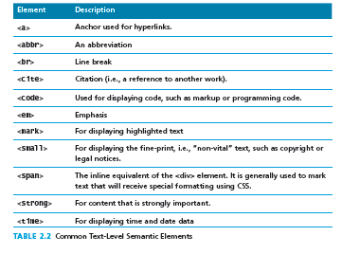
Inline Text Elements
Do not disrupt the flow
Inline elements do not disrupt the flow of text (i.e., cause a line break).
HTML5 defines over 30 of these elements.

Slide 59
Images
While the <img> tag is the oldest method for displaying an image, it is not the only way.
For purely decorative images, such as background gradients and patterns, logos, border art, and so on, it makes semantic sense to keep such images out of the markup and in CSS where they more rightly belong.
But when the images are content, such as in the images in a gallery or the image of a product in a product details page, then the <img> tag is the semantically appropriate approach.

Slide 60
Images

Slide 61
Lists
HTML provides three types of lists
Unordered lists. Collections of items in no particular order; these are by default rendered by the browser as a bulleted list.
Ordered lists. Collections of items that have a set order; these are by default rendered by the browser as a numbered list.
Definition lists. Collection of name and definition pairs. These tend to be used infrequently. Perhaps the most common example would be a FAQ list.

Slide 62
Lists

Slide 63
Character Entities
These are special characters for symbols for which there is either no way easy way to type in via a keyboard (such as the copyright symbol or accented characters) or which have a reserved meaning in HTML (for instance the “<” or “>” symbols).
They can be used in an HTML document by using the entity name or the entity number.
e.g., &nbsp; and &copy;

Slide 64
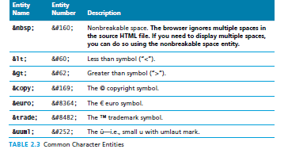

Slide 65
HTML SEMANTIC ELEMENTS
Section 6 of 6

Slide 66
Header and Footer
<header> <footer>
Most web site pages have a recognizable header and footer section.
Typically the header contains
the site logo
title (and perhaps additional subtitles or taglines)
horizontal navigation links, and
perhaps one or two horizontal banners.

Slide 67
Header and Footer
<header> <footer>
The typical footer contains less important material, such as
smaller text versions of the navigation,
copyright notices,
information about the site’s privacy policy, and
perhaps twitter feeds or links to other social sites.

Slide 68
Header and Footer
Both the HTML5 <header> and <footer> element can be used not only for page headers and footers, they can also be used for header and footer elements within other HTML5 containers, such as <article> or <section>.
<header>
<img src="logo.gif" alt="logo" />
<h1>Fundamentals of Web Development</h1>
...
</header>
<article>
<header>
<h2>HTML5 Semantic Structure Elements </h2>
<p>By <em>Randy Connolly</em></p>
<p><time>September 30, 2012</time></p>
</header>
...
</article>

Slide 69
Heading Groups
<hgroup>
The <hgroup> element can be used to group related headings together within one container.
<header>
<hgroup>
<h1>Chapter Two: HTML 1</h1>
<h2>An Introduction</h2>
</hgroup>
</header>
<article>
<hgroup>
<h2>HTML5 Semantic Structure Elements </h2>
<h3>Overview</h3>
</hgroup>
</article>

Slide 70
Navigation
<nav>
The <nav> element represents a section of a page that contains links to other pages or to other parts within the same page.
Like the other new HTML5 semantic elements, the browser does not apply any special presentation to the <nav> element.
The <nav> element was intended to be used for major navigation blocks, presumably the global and secondary navigation systems.

Slide 71
Navigation
<header>
<img src="logo.gif" alt="logo" />
<h1>Fundamentals of Web Development</h1>
<nav role="navigation">
<ul>
<li><a href="index.html">Home</a></li>
<li><a href="about.html">About Us</a></li>
<li><a href="browse.html">Browse</a></li>
</ul>
</nav>
</header>

Slide 72
Articles and Sections
<article> <section>
The <article> element represents a section of content that forms an independent part of a document or site; for example, a magazine or newspaper article, or a blog entry.
The <section> element represents a section of a document, typically with a title or heading.
According to the W3C, <section> is a much broader element, while the <article> element is to be used for blocks of content that could potentially be read or consumed independently of the other content on the page.

Slide 73
Sections versus Divs
How to decide which to use
The WHATWG specification warns readers that the <section> element is not a generic container element. HTML already has the <div> element for such uses.
When an element is needed only for styling purposes or as a convenience for scripting, it makes sense to use the <div> element instead.
Another way to help you decide whether or not to use the <section> element is to ask yourself if it is appropriate for the element's contents to be listed explicitly in the document's outline.
If so, then use a <section>; otherwise use a <div>.

Slide 74
Figure and Figure Captions
<figure> <figcaption>
The W3C Recommendation indicates that the <figure> element can be used not just for images but for any type of essential content that could be moved to a different location in the page or document and the rest of the document would still make sense.
The <figure> element should not be used to wrap every image.
For instance, it makes no sense to wrap the site logo or non-essential images such as banner ads and graphical embellishments within <figure> elements.
Instead, only use the <figure> element for circumstances where the image (or other content) has a caption and where the figure is essential to the content but its position on the page is relatively unimportant.

Slide 75
Figure and Figure Captions

Slide 76
Aside
<aside>
The <aside> element is similar to the <figure> element in that it is used for marking up content that is separate from the main content on the page.
But while the <figure> element was used to indicate important information whose location on the page is somewhat unimportant, the <aside> element “represents a section of a page that consists of content that is tangentially related to the content around the aside element.”
The <aside> element could thus be used for sidebars, pull quotes, groups of advertising images, or any other grouping of non-essential elements.

Slide 77
XHTML versus HTML5

Slide 78
CSS 1: Introduction
Chapter 3

Slide 79
Objectives
1
2
What is CSS?
CSS Syntax
3
4
Location of Styles
Selectors
5
6
The Cascade: How Styles Interact
The Box Model
7
CSS Text Styling

Slide 80
WHAT IS CSS?
Section 1 of 7

Slide 81
What is CSS?
You be styling soon
CSS is a W3C standard for describing the presentation (or appearance) of HTML elements.
With CSS, we can assign
font properties,
colors,
sizes,
borders,
background images,
even the position of elements.

Slide 82
What is CSS?
You be styling soon
CSS is a language in that it has its own syntax rules.
CSS can be added directly to any HTML element (via the style attribute), within the <head> element, or, most commonly, in a separate text file that contains only CSS.

Slide 83
Benefits of CSS
Why using CSS is a better way of describing presentation than HTML
The degree of formatting control in CSS is significantly better than that provided in HTML.
Web sites become significantly more maintainable because all formatting can be centralized into one, or a small handful, of CSS files.
CSS-driven sites are more accessible.
A site built using a centralized set of CSS files for all presentation will also be quicker to download because each individual HTML file will contain less markup.
CSS can be used to adopt a page for different output mediums.

Slide 84
CSS Versions
Let’s just say there’s more than 1
W3C published the CSS Level 1 Recommendation in 1996.
A year later, the CSS Level 2 Recommendation (also more succinctly labeled simply as CSS2) was published.
Even though work began over a decade ago, an updated version of the Level 2 Recommendation, CSS2.1, did not become an official W3C Recommendation until June 2011.
And to complicate matters even more, all through the last decade (and to the present day as well), during the same time the CSS2.1 standard was being worked on, a different group at the W3C was working on a CSS3 draft.

Slide 85
Browser Adoption
Insert obligatory snide comment about Internet Explorer 6 here
While Microsoft’s Internet Explorer was an early champion of CSS, its later versions (especially IE5, IE6, and IE7) for Windows had uneven support for certain parts of CSS2.
In fact, all browsers have left certain parts of the CSS2 Recommendation unimplemented.
CSS has a reputation for being a somewhat frustrating language.
this reputation is well deserved!

Slide 86
CSS Syntax
Section 2 of 7

Slide 87
CSS Syntax
Rules, properties, values, declarations
A CSS document consists of one or more style rules.
A rule consists of a selector that identifies the HTML element or elements that will be affected, followed by a series of property and value pairs (each pair is also called a declaration).

Slide 88
Declaration Blocks
The series of declarations is also called the declaration block.
A declaration block can be together on a single line, or spread across multiple lines.
The browser ignores white space
Each declaration is terminated with a semicolon.

Slide 89
Selectors
Which elements
Every CSS rule begins with a selector.
The selector identifies which element or elements in the HTML document will be affected by the declarations in the rule.
Another way of thinking of selectors is that they are a pattern which is used by the browser to select the HTML elements that will receive the style.

Slide 90
Properties
Which style properties of the selected elements
Each individual CSS declaration must contain a property.
These property names are predefined by the CSS standard.
The CSS2.1 Recommendation defines over a hundred different property names.

Slide 91
Properties
Common CSS properties
Property Type | Property
Fonts | font font-family font-size font-style font-weight @font-face
Text | letter-spacing line-height text-align text-decoration text-indent
Color and background | background background-color background-image background-position background-repeat color
Borders | border border-color border-width border-style border-top border-top-color border-top-width etc

Slide 92
Properties
Common CSS properties continued.
Property Type | Property
Spacing | padding padding-bottom, padding-left, padding-right, padding-top margin margin-bottom, margin-left, margin-right, margin-top
Sizing | height max-height max-width min-height min-width width
Layout | bottom, left, right, top clear display float overflow position visibility z-index
Lists | list-style list-style-image list-style-type

Slide 93
Values
What style value for the properties
Each CSS declaration also contains a value for a property.
The unit of any given value is dependent upon the property.
Some property values are from a predefined list of keywords.
Others are values such as length measurements, percentages, numbers without units, color values, and URLs.

Slide 94
Color Values
CSS supports a variety of different ways of describing color
Method | Description | Example
Name | Use one of 17 standard color names. CSS3 has 140 standard names. | color: red; color: hotpink; /* CSS3 only */
RGB | Uses three different numbers between 0 and 255 to describe the Red, Green, and Blue values for the color. | color: rgb(255,0,0); color: rgb(255,105,180);
Hexadecimal | Uses a six-digit hexadecimal number to describe the red, green, and blue value of the color; each of the three RGB values is between 0 and FF (which is 255 in decimal). Notice that the hexadecimal number is preceded by a hash or pound symbol (#). | color: #FF0000; color: #FF69B4;
RGBa | Allows you to add an alpha, or transparency, value. This allows a background color or image to “show through” the color. Transparency is a value between 0.0 (fully transparent) and 1.0 (fully opaque). | color: rgb(255,0,0, 0.5);
HSL | Allows you to specify a color using Hue Saturation and Light values. This is available only in CSS3. HSLA is also available as well. | color: hsl(0,100%,100%); color: hsl(330,59%,100%);

Slide 95
Units of Measurement
There are multiple ways of specifying a unit of measurement in CSS
Some of these are relative units, in that they are based on the value of something else, such as the size of a parent element.
Others are absolute units, in that they have a real-world size.
Unless you are defining a style sheet for printing, it is recommended to avoid using absolute units.
Pixels are perhaps the one popular exception (though as we shall see later there are also good reasons for avoiding the pixel unit).

Slide 96
Relative Units
Unit | Description | Type
px | Pixel. In CSS2 this is a relative measure, while in CSS3 it is absolute (1/96 of an inch). | Relative (CSS2) Absolute (CSS3)
em | Equal to the computed value of the font-size property of the element on which it is used. When used for font sizes, the em unit is in relation to the font size of the parent. | Relative
% | A measure that is always relative to another value. The precise meaning of % varies depending upon which property it is being used. | Relative
ex | A rarely used relative measure that expresses size in relation to the x-height of an element’s font. | Relative
ch | Another rarely used relative measure; this one expresses size in relation to the width of the zero ("0") character of an element’s font. | Relative (CSS3 only)
rem | Stands for root em, which is the font size of the root element. Unlike em, which may be different for each element, the rem is constant throughout the document. | Relative (CSS3 only)
vw, vh | Stands for viewport width and viewport height. Both are percentage values (between 0 and 100) of the viewport (browser window). This allows an item to change size when the viewport is resized. | Relative (CSS3 only)

Slide 97
Absolute Units
Unit | Description | Type
in | Inches | Absolute
cm | Centimeters | Absolute
mm | Millimeters | Absolute
pt | Points (equal to 1/72 of an inch) | Absolute
pc | Pica (equal to 1/6 of an inch) | Absolute

Slide 98
Comments in CSS
It is often helpful to add comments to your style sheets. Comments take the form:
/* comment goes here */

Slide 99
location of styles
Section 3 of 7

Slide 100
Actually there are three …
Different types of style sheet
Author-created style sheets (what we are learning in this presentation).
User style sheets allow the individual user to tell the browser to display pages using that individual’s own custom style sheet. This option is available in a browser usually in its accessibility options area.
The browser style sheet defines the default styles the browser uses for each HTML element.

Slide 101
Style Locations
Author Created CSS style rules can be located in three different locations
CSS style rules can be located in three different locations.
Inline
Embedded
External
You can combine all 3!

Slide 102
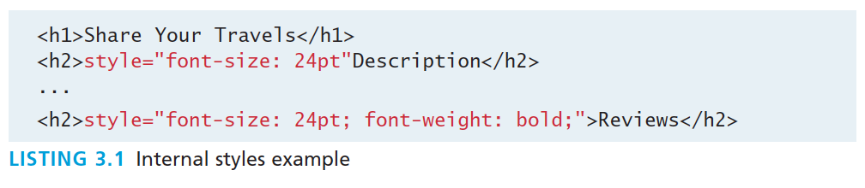
Inline Styles
Style rules placed within an HTML element via the style attribute
An inline style only affects the element it is defined within and will override any other style definitions for the properties used in the inline style.
Using inline styles is generally discouraged since they increase bandwidth and decrease maintainability.
Inline styles can however be handy for quickly testing out a style change.

Slide 103
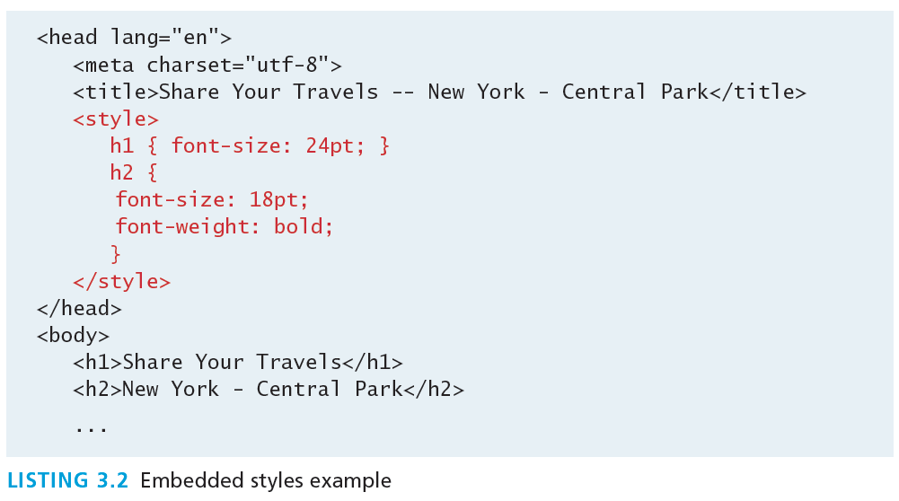
Embedded Style Sheet
Style rules placed within the <style> element inside the <head> element
While better than inline styles, using embedded styles is also by and large discouraged.
Since each HTML document has its own <style> element, it is more difficult to consistently style multiple documents when using embedded styles.

Slide 104
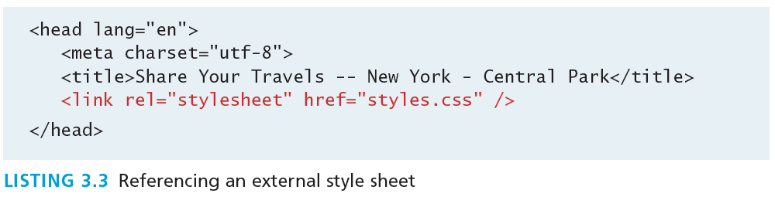
External Style Sheet
Style rules placed within a external text file with the .css extension
This is by far the most common place to locate style rules because it provides the best maintainability.
When you make a change to an external style sheet, all HTML documents that reference that style sheet will automatically use the updated version.
The browser is able to cache the external style sheet which can improve the performance of the site

Slide 105
SELECTORS
Section 4 of 7

Slide 106
Selectors
Things that make your life easier
When defining CSS rules, you will need to first need to use a selector to tell the browser which elements will be affected.
CSS selectors allow you to select
individual elements
multiple HTML elements,
elements that belong together in some way, or
elements that are positioned in specific ways in the document hierarchy.
There are a number of different selector types.

Slide 107
Element Selectors
Selects all instances of a given HTML element
Uses the HTML element name.
You can select all elements by using the universal element selector, which is the * (asterisk) character.

Slide 108
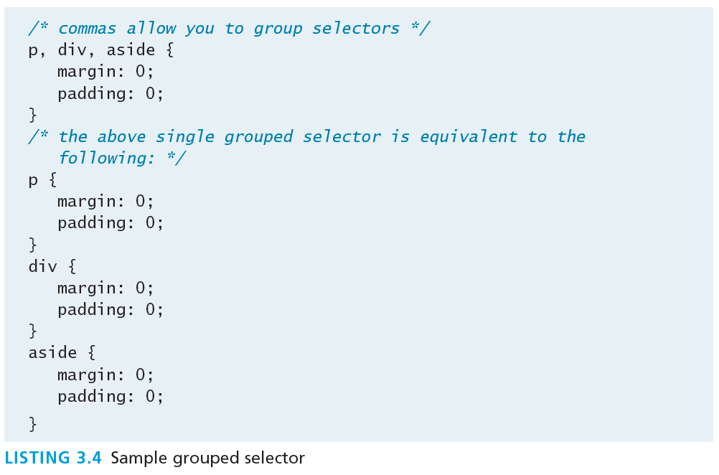
Grouped Selectors
Selecting multiple things
You can select a group of elements by separating the different element names with commas.
This is a sensible way to reduce the size and complexity of your CSS files, by combining multiple identical rules into a single rule.

Slide 109
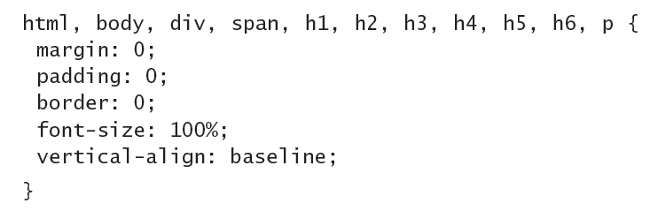
Reset
Grouped selectors are often used as a way to quickly reset or remove browser defaults.
The goal of doing so is to reduce browser inconsistencies with things such as margins, line heights, and font sizes.
These reset styles can be placed in their own css file (perhaps called reset.css) and linked to the page before any other external styles sheets.

Slide 110
Class Selectors
Simultaneously target different HTML elements
A class selector allows you to simultaneously target different HTML elements regardless of their position in the document tree.
If a series of HTML element have been labeled with the same class attribute value, then you can target them for styling by using a class selector, which takes the form: period (.) followed by the class name.

Slide 111
Class Selectors
<head>
<title>Share Your Travels </title>
<style>
.first {
font-style: italic;
color: brown;
}
</style>
</head>
<body>
<h1 class="first">Reviews</h1>
<div>
<p class="first">By Ricardo on <time>September 15, 2012</time></p>
<p>Easy on the HDR buddy.</p>
</div>
<hr/>
<div>
<p class="first">By Susan on <time>October 1, 2012</time></p>
<p>I love Central Park.</p>
</div>
<hr/>
</body>

Slide 112
Id Selectors
Target a specific element by its id attribute
An id selector allows you to target a specific element by its id attribute regardless of its type or position.
If an HTML element has been labeled with an id attribute, then you can target it for styling by using an id selector, which takes the form: pound/hash (#) followed by the id name.
Note: You should only be using an id once per page

Slide 113
Id Selectors
<head lang="en">
<meta charset="utf-8">
<title>Share Your Travels -- New York - Central Park</title>
<style>
#latestComment {
font-style: italic;
color: brown;
}
</style>
</head>
<body>
<h1>Reviews</h1>
<div id="latestComment">
<p>By Ricardo on <time>September 15, 2012</time></p>
<p>Easy on the HDR buddy.</p>
</div>
<hr/>
<div>
<p>By Susan on <time>October 1, 2012</time></p>
<p>I love Central Park.</p>
</div>
<hr/>
</body>

Slide 114
Id versus Class Selectors
How to decide
Id selectors should only be used when referencing a single HTML element since an id attribute can only be assigned to a single HTML element.
Class selectors should be used when (potentially) referencing several related elements.

Slide 115
Attribute Selectors
Selecting via presence of element attribute or by the value of an attribute
An attribute selector provides a way to select HTML elements by either the presence of an element attribute or by the value of an attribute.
This can be a very powerful technique, but because of uneven support by some of the browsers, not all web authors have used them.
Attribute selectors can be a very helpful technique in the styling of hyperlinks and images.

Slide 116
Attribute Selectors
<head lang="en">
<meta charset="utf-8">
<title>Share Your Travels</title>
<style>
[title] {
cursor: help;
padding-bottom: 3px;
border-bottom: 2px dotted blue;
text-decoration: none;
}
</style>
</head>
<body>
<div>
<img src="images/flags/CA.png" title="Canada Flag" />
<h2><a href="countries.php?id=CA" title="see posts from Canada">
Canada</a>
</h2>
<p>Canada is a North American country consisting of … </p>
<div>
<img src="images/square/6114907897.jpg" title="At top of Sulpher Mountain">
<img src="images/square/6592317633.jpg" title="Grace Presbyterian Church">
<img src="images/square/6592914823.jpg" title="Calgary Downtown">
</div>
</div>
</body>

Slide 117
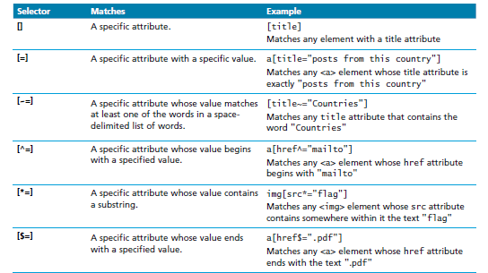
Attribute Selectors

Slide 118
Pseudo Selectors
Select something that does not exist explicitly as an element
A pseudo-element selector is a way to select something that does not exist explicitly as an element in the HTML document tree but which is still a recognizable selectable object.
A pseudo-class selector does apply to an HTML element, but targets either a particular state or, in CSS3, a variety of family relationships.
The most common use of this type of selectors is for targeting link states.

Slide 119
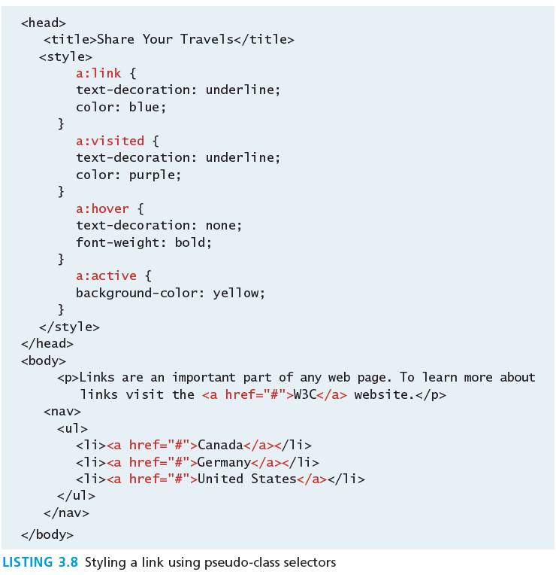
Pseudo Selectors

Slide 120
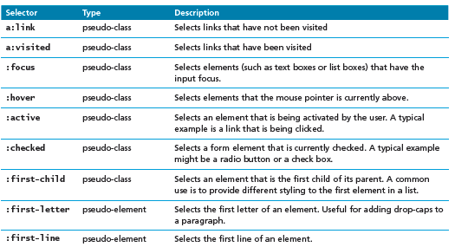
Common Pseudo-Class and Pseudo-Element Selectors

Slide 121
Contextual Selectors
Select elements based on their ancestors, descendants, or siblings
A contextual selector (in CSS3 also called combinators) allows you to select elements based on their ancestors, descendants, or siblings.
That is, it selects elements based on their context or their relation to other elements in the document tree.

Slide 122
Contextual Selectors
Selector | Matches | Example
Descendant | A specified element that is contained somewhere within another specified element | div p Selects a <p> element that is contained somewhere within a <div> element. That is, the <p> can be any descendant, not just a child.
Child | A specified element that is a direct child of the specified element | div>h2 Selects an <h2> element that is a child of a <div> element.
Adjacent Sibling | A specified element that is the next sibling (i.e., comes directly after) of the specified element. | h3+p Selects the first <p> after any <h3>.
General Sibling | A specified element that shares the same parent as the specified element. | h3~p Selects all the <p> elements that share the same parent as the <h3>.

Slide 123
Contextual Selectors in Action

Slide 124
Descendant Selector
Selects all elements that are contained within another element
While some of these contextual selectors are used relatively infrequently, almost all web authors find themselves using descendant selectors.
A descendant selector matches all elements that are contained within another element. The character used to indicate descendant selection is the space character.

Slide 125
The cascade: how styles interact
Section 5 of 7

Slide 126
Why Conflict Happens
In CSS that is
Because
there are three different types of style sheets (author-created, user-defined, and the default browser style sheet),
author-created stylesheets can define multiple rules for the same HTML element,
CSS has a system to help the browser determine how to display elements when different style rules conflict.

Slide 127
Cascade
How conflicting rules are handled in CSS
The “Cascade” in CSS refers to how conflicting rules are handled.
The visual metaphor behind the term cascade is that of a mountain stream progressing downstream over rocks.
The downward movement of water down a cascade is meant to be analogous to how a given style rule will continue to take precedence with child elements.

Slide 128
Cascade Principles
CSS uses the following cascade principles to help it deal with conflicts:
inheritance,
specificity,
location

Slide 129
Inheritance
Cascade Principle #1
Many (but not all) CSS properties affect not only themselves but their descendants as well.
Font, color, list, and text properties are inheritable.
Layout, sizing, border, background and spacing properties are not.

Slide 130
Inheritance

Slide 131
Inheritance
How to force inheritance
It is possible to tell elements to inherit properties that are normally not inheritable.

Slide 132
Inheritance

Slide 133
Specificity
Cascade Principle #2
Specificity is how the browser determines which style rule takes precedence when more than one style rule could be applied to the same element.
The more specific the selector, the more it takes precedence (i.e., overrides the previous definition).

Slide 134
Specificity
How it works
The way that specificity works in the browser is that the browser assigns a weight to each style rule.
When several rules apply, the one with the greatest weight takes precedence.

Slide 135
Specificity
These color and font-weight properties are inheritable and thus potentially applicable to all the child elements contained within the body.
However, because the <div> and <p> elements also have the same properties set, they override the value defined for the <body> element because their selectors (div and p) are more specific.
Class selectors are more specific than element selectors, and thus take precedence and override element selectors.
Id selectors are more specific than class selectors, and thus take precedence and override class selectors.

Slide 136
Specificity Algorithm
The algorithm that is used to determine specificity is :
First count 1 if the declaration is from a 'style' attribute in the HTML, 0 otherwise (let that value = a).
Count the number of ID attributes in the selector (let that value = b).
Count the number of other attributes and pseudo-classes in the selector (let that value = c).
Count the number of element names and pseudo-elements in the selector (let that value = d).
Finally, concatenate the four numbers a+b+c+d together to calculate the selector’s specificity.

Slide 137
Specificity Algorithm

Slide 138
Location
Cascade Principle #3
When inheritance and specificity cannot determine style precedence, the principle of location will be used.
The principle of location is that when rules have the same specificity, then the latest are given more weight.

Slide 139
Location
Can you guess what will be the color of the sample text ?

Slide 140
Location
What color would the sample text be if there wasn’t an inline style definition?

Slide 141
Location
There’s always an exception
There is one exception to the principle of location.
If a property is marked with !important in an author-created style rule, then it will override any other author-created style regardless of its location.
The only exception is a style marked with !important in an user style sheet; such a rule will override all others.

Slide 142
The BOX MODEL
Section 6 of 7

Slide 143
The Box Model
Time to think inside the box
In CSS, all HTML elements exist within an element box.
It is absolutely essential that you familiarize yourself with the terminology and relationship of the CSS properties within the element box.

Slide 144
The Box Model

Slide 145
Background
Box Model Property #1
The background color or image of an element fills an element out to its border (if it has one that is).
In contemporary web design, it has become extremely common too use CSS to display purely presentational images (such as background gradients and patterns, decorative images, etc) rather than using the <img> element.

Slide 146
Background Properties
Property | Description
background | A combined short-hand property that allows you to set the background values in one property. While you can omit properties with the short-hand, do remember that any omitted properties will be set to their default value.
background-attachment | Specifies whether the background image scrolls with the document (default) or remains fixed. Possible values are: fixed, scroll.
background-color | Sets the background color of the element.
background-image | Specifies the background image (which is generally a jpeg, gif, or png file) for the element. Note that the URL is relative to the CSS file and not the HTML. CSS3 introduced the ability to specify multiple background images.
background-position | Specifies where on the element the background image will be placed. Some possible values include: bottom, center, left, and right. You can also supply a pixel or percentage numeric position value as well. When supplying a numeric value, you must supply a horizontal/vertical pair; this value indicates its distance from the top left corner of the element.
background-repeat | Determines whether the background image will be repeated. This is a common technique for creating a tiled background (it is in fact the default behavior). Possible values are: repeat, repeat-x, repeat-y, and no-repeat.
background-size | New to CSS3, this property lets you modify the size of the background image.

Slide 147
Background Repeat

Slide 148
Background Position

Slide 149
Borders
Box Model Property #2
Borders provide a way to visually separate elements.
You can put borders around all four sides of an element, or just one, two, or three of the sides.

Slide 150
Borders
Property | Description
border | A combined short-hand property that allows you to set the style, width, and color of a border in one property. The order is important and must be: border-style border-width border-color
border-style | Specifies the line type of the border. Possible values are: solid, dotted, dashed, double, groove, ridge, inset, and outset.
border-width | The width of the border in a unit (but not percents). A variety of keywords (thin, medium, etc) are also supported.
border-color | The color of the border in a color unit.
border-radius | The radius of a rounded corner.
border-image | The URL of an image to use as a border.

Slide 151
Shortcut notation
TRBL
With border, margin, and padding properties, there are long-form and shortcut methods to set the 4 sides
border-top-color: red; /* sets just the top side */
border-right-color: green; /* sets just the right side */
border-bottom-color: yellow; /* sets just the bottom side */
border-left-color: blue; /* sets just the left side */
border-color: red; /* sets all four sides to red */
border-color: red green orange blue; /* sets all four sides differently */
When using this multiple values shortcut, they are applied in clockwise order starting at the top.
Thus the order is: top right bottom left.

Slide 152
Margins and Padding
Box Model Properties #3 and #4

Slide 153
Margins
Why they will cause you trouble.
Did you notice that the space between paragraphs one and two and between two and three is the same as the space before paragraph one and after paragraph three?
This is due to the fact that adjoining vertical margins collapse.

Slide 154
Collapsing Margins
If overlapping margins did not collapse, then margin space for would be 180p (90pixels for the bottom margin of the first <div> + 90 pixels for the top margin of the second <div>), while the margins and for would be 100px.
However, as you can see this is not the case.

Slide 155
Collapsing Margins
How it works
When the vertical margins of two elements touch,
the largest margin value of the elements will be displayed
the smaller margin value will be collapsed to zero.
Horizontal margins, on the other hand, never collapse.
To complicate matters even further, there are a large number of special cases in which adjoining vertical margins do not collapse.

Slide 156
Width and Height
Box Model Properties #5 and #6
The width and height properties specify the size of the element’s content area.
Perhaps the only rival for collapsing margins in troubling our students, box dimensions have a number of potential issues.

Slide 157
Width and Height
Potential Problem #1
Only block-level elements and non-text inline elements such as images have a width and height that you can specify.
By default the width of and height of elements is the actual size of the content.
For text,
this is determined by the font size and font face;
For images,
the width and height of the actual image in pixels determines the element box’s dimensions.

Slide 158
Width and Height
Potential Problem #2
Since the width and the height refer to the size of the content area, by default, the total size of an element is equal to not only its content area, but also to the sum of its padding, borders, and margins.

Slide 159
Default

Slide 160
Width and Height

Slide 161
Overflow Property

Slide 162
Sizing Elements
Time to embrace ems and percentages
While the previous examples used pixels for its measurement, many contemporary designers prefer to use percentages or em units for widths and heights.
When you use percentages, the size is relative to the size of the parent element.
When you use ems, the size of the box is relative to the size of the text within it.
The rationale behind using these relative measures is to make one’s design scalable to the size of the browser or device that is viewing it.

Slide 164
Developer Tools
Help is on the way
Developer tools in current browsers make it significantly easier to examine and troubleshot CSS than was the case a decade ago.
You can use the various browsers’ CSS inspection tools to examine, for instance, the box values for a selected element.

Slide 165
Developer Tools

Slide 166
TEXT STYLING
Section 7 of 7

Slide 167
Text Properties
Two basic types
CSS provides two types of properties that affect text.
font properties that affect the font and its appearance.
paragraph properties that affect the text in a similar way no matter which font is being used.

Slide 168
Font-Family
A few issues here
A word processor on a desktop machine can make use of any font that is installed on the computer; browsers are no different.
However, just because a given font is available on the web developer’s computer, it does not mean that that same font will be available for all users who view the site.
For this reason, it is conventional to supply a so-called web font stack, that is, a series of alternate fonts to use in case the original font choice in not on the user’s computer.

Slide 169
Specifying the Font-Family

Slide 170
Generic Font-Family
The font-family property supports five different generic families.
The browser supports a typeface from each family.

Slide 171
@font-face
The future is now
Over the past few years, the most recent browser versions have begun to support the @font-face selector in CSS.
This selector allows you to use a font on your site even if it is not installed on the end user’s computer.
Due to the on-going popularity of open source font sites such as Google Web Fonts (http://www.google.com/webfonts) and Font Squirrel (http://www.fontsquirrel.com/), @font-face seems to have gained a critical mass of widespread usage.

Slide 172
Font Sizes
Mo control, mo problems
The issue of font sizes is unfortunately somewhat tricky.
In a print-based program such as a word processor, specifying a font size in points is unproblematic.
However, absolute units such as points and inches do not translate very well to pixel-based devices.
Somewhat surprisingly, pixels are also a problematic unit.
Newer mobile devices in recent years have been increasing pixel densities so that a given CSS pixel does not correlate to a single device pixel.

Slide 173
Font Sizes
Welcome ems and percents again
If we wish to create web layouts that work well on different devices, we should learn to use relative units such as em units or percentages for our font sizes (and indeed for other sizes in CSS as well).
One of the principles of the web is that the user should be able to change the size of the text if he or she so wishes to do so.
Using percentages or em units ensures that this user action will work.

Slide 174
How to use ems and percents
When used to specify a font size, both em units and percentages are relative to the parent’s font size.

Slide 175
How to use ems and percents

Slide 176
How to use ems and percents
It might seem easy … but it’s not …
While this looks pretty easy to master, things unfortunately can quickly become quite complicated.
Remember that percents and em units are relative to their parents, so if the parent font size changes, this affects all of its contents.

Slide 177
ems and percents

Slide 178
The rem unit
Solution to font sizing hassles?
CSS3 now supports a new relative measure, the rem (for root em unit).
This unit is always relative to the size of the root element (i.e., the <html> element).
However, since Internet Explorer prior to version 9 do not support the rem units, you need to provide some type of fallback for those browsers.

Slide 179
The rem unit

Slide 180
End of Module 1

